Slide 1



SUSTAINING A BALANCED & PRODUCTIVE
WORKPLACE

Slide 2

JOIN US TO EXPLORE STRATEGIES FOR CREATING A POSITIVE AND HEALTHY WORKPLACE.
Let’s encourage practices that support mental and physical health, leading to a thriving and engaged workforce.

Slide 3



WHY IT MATTERS
IMPROVED MORALE
INCREASED PRODUCTIVITY
REDUCED ABSENTEEISM
Boosts employee satisfaction and engagement.
Healthy employees are more focused and efficient.
Fewer health-related absences benefit overall operations.

Slide 4


CREATING COMFORTABLE WORKSPACES AND PROMOTING MOVEMENT
Ergonomic furniture, posture education, and movement breaks enhance comfort and reduce strain.
Incorporating activity breaks, fitness programs, and wellness challenges promotes a healthy workplace.

Slide 5





FUELING THE BODY AND FOSTERING EMOTIONAL WELL-BEING
HEALTHY SNACKS
HYDRATION STATIONS
MINDFULNESS PRACTICES
BALANCED MEALS
OPEN COMMUNICATION
COUNSELING SERVICES

Slide 6


BALANCING PROFESSIONAL AND PERSONAL LIFE
While failing to set boundaries, ignoring task prioritization, skipping downtime, neglecting mindfulness, and avoiding seeking help lead to stress and imbalance.
Balancing professional and personal life requires clear boundaries, task prioritization, scheduled downtime, mindfulness, and seeking support as needed.

Slide 7


CULTIVATING A
SUPPORTIVE ENVIRONMENT
TEAM BUILDING
Organize regular team activities and social events.
DIVERSITY & INCLUSION
Foster a workplace that values all voices and backgrounds.

Slide 8




ENSURING A SAFE ENVIRONMENT
REGULAR INSPECTIONS
PROPER TRAINING
SAFETY PROTOCOLS
IGNORING REGULATIONS
NEGLECTING MAINTENANCE
INSUFFICIENT TRAINING

Slide 9
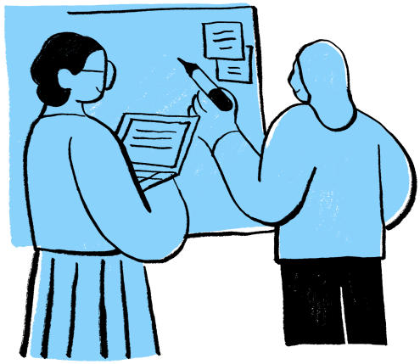

COMMITMENT TO CONTINUOUS DEVELOPMENT
ENGAGE & EMPOWER
Actively encourage wider participation in health programs.
AIM FOR EXCELLENCE
Strive for a workplace that prioritizes well-being in every aspect.

Slide 10

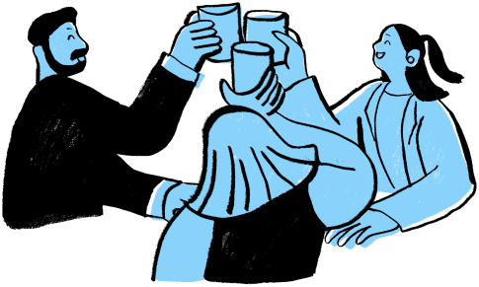
JOIN THE HEALTHY WORKPLACE MOVEMENT!

